Slide 1
Laboratory Practical - 3 ML Mini Project Report
Group Members :- Tanay Zope 19CO074 Saba Syed 19CO065 Sagnik Roy 18CO061

Slide 2
Introduction
Problem Statement
Daily traffic is a nuisance in our lives but it would be better if we knew how much traffic is present at a time.
In this challenge we perform a complete analysis to understand the parameters that affect traffic of a city.
In particular, we apply the tools of machine learning to predict the traffic of a city at a certain time.
Develop a Machine Learning model to forecast twelve-hours of traffic flow in a U.S. metropolis using parameters like time,direction,coordinates etc.
Dataset Link: https://www.kaggle.com/competitions/tabular-playground-series-mar-2022/data

Slide 3
Objective
Scope
There may be certain unexpected conditions like car wrecks,road damages but for everyday purposes the traffic is based on certain parameters like time etc.
To build a model for prediction.
To analyze its performance on Chicago Traffic Tracker - Historical Congestion Estimates dataset. .
Predicting the congestion of traffic in the city.
To use diﬀerent ML concepts to optimize the model’s performance.

Slide 4
Numpy >= 1.18.2
System Requirements:
Pandas >= 1.0.3
Matplotlib >= 1.0.1
Seaborn >= 1.8.5
Operating System : 64 bit Linux or its derivatives / Windows.
Python Programming Language >= 3.6
Scikit Learn >= 1.1.3
Jupyter Notebook >= 4.1.11
Pip >= 3.0.2

Slide 5

Theory
Scikit Learn
Scikit-learn is a free machine learning library for Python.
It features various algorithms like support vector machine, random forests, and k-neighbours, and it also supports Python numerical and scientiﬁc libraries like NumPy and SciPy.
Simple and eﬃcient tools for predictive data analysis
Accessible to everybody, and reusable in various contexts
Built on NumPy, SciPy, and matplotlib
Open source, commercially usable - BSD license

Slide 6
CatBoost Regression
CatBoost builds upon the theory of decision trees and gradient boosting. The main idea of boosting is to sequentially combine many weak models (a model performing slightly better than random chance) and thus through greedy search create a strong competitive predictive model.
Gradient boosting fits the decision trees sequentially, the fitted trees will learn from the mistakes of former trees and hence reduce the errors. This process of adding a new function to existing ones is continued until the selected loss function is no longer minimized.
One of CatBoost’s core edges is its ability to integrate a variety of different data types, such as images, audio, or text features into one framework. But CatBoost also offers an idiosyncratic way of handling categorical data, requiring a minimum of categorical feature transformation, opposed to the majority of other machine learning algorithms, that cannot handle non-numeric values.

Slide 7
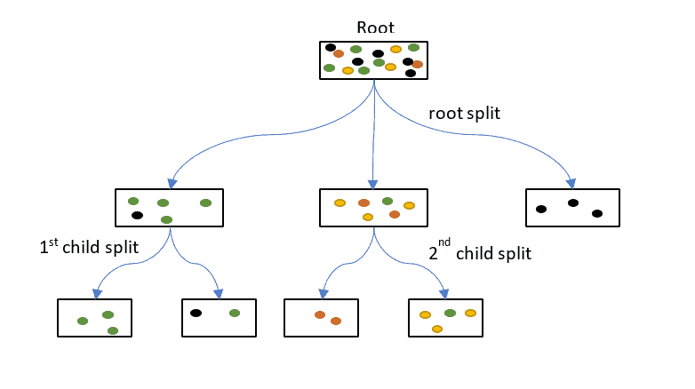
It is not always as clear when to use random forests vs when to use gradient boosting. There are several sophisticated gradient boosting libraries out there (lightgbm, xgboost and catboost) that will probably outperform random forests for most types of problems.

Slide 8
Benefits of the CatBoost Machine Learning Algorithm
One of the most frustrating parts of data science is, well, the data. That data can include a variety of forms, but perhaps the main one that causes all the problems is that of the categorical feature type. This type can also be described as a string, object, or categorical dtype more specifically.
It has effective usage with default parameters thereby reducing the time needed for parameter tuning.
CatBoost uses ordered target encoding, which essentially allows you to keep the feature/column in its original state, allowing you to collaborate with ml engineers and software engineers more easily.
The last benefit of CatBoost is a product of the first benefit. Because you do not have a sparse dataframe, the processing of your model that uses plenty amount of categorical features is much faster than if you used other algorithms like XGBoost or Random Forest.

Slide 9
Metrics for Accuracy Measurement
Evaluating the model accuracyegression model in Python.
MAE (Mean absolute error) represents the differenced by averaged the absolute difference over the data set.
MSE (Mean Squared Error) represents the difference between the
original and predicted values extracted by squared the average difference over the data set.
R-squared (Coefficient of determination) represents the coefficient of how well the values fit compared to the original values. The value from 0 to 1 interpreted as percentages. The higher the value is, the better the model is.

Slide 10
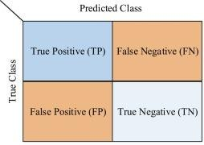
The confusion matrix consists of four basic characteristics (numbers) that are used to deﬁne the measurement metrics of the classiﬁer. These four numbers are:
TP (True Positive): TP represents the number of patients who have been properly classiﬁed to have malignant nodes, meaning they have the disease.
TN (True Negative): TN represents the number of correctly classiﬁed patients who are healthy.
FP (False Positive): FP represents the number of misclassiﬁed patients with the disease but actually they are healthy. FP is also known as a Type I error.
FN (False Negative): FN represents the number of patients misclassiﬁed as healthy but actually they are suﬀering from the disease. FN is also known as a Type II error.

Slide 11
Modules Used
Numpy : NumPy is a Python library used
for working with arrays.
Pandas : For Data Processing in the Notebook.
Matplotlib :For Plotting charts and graphs for better visualization.
Seaborn : For lightweight, powerful visualization of data.
Scikit learn: Scikit-learn is a library in Python that provides many unsupervised and supervised learning algorithms.

Slide 12
Algorithm
Import Necessary libraries and datasets.
Take a statistical look at the dataset.
Handle missing values in the dataset.
Plot various graphs for gaining insights from the data visualization process.
Do feature selection.
Split dataset into training and validation set and perform Standard Scaling.
Build the CatBoost Regressor Model.
Compile and train the model using the training dataset.
Get predictions on Validation dataset and display model evaluation results.
Use it to predict on the unseen Testing dataset.

Slide 13
Results
The model performed well with an accuracy of 77.34%.
Mean absolute error: 5.34
Mean squared error: 56.98
Coefficient of determination/Accuracy: 77.34%

Slide 14
Conclusion
Hence, a machine learning model using CatBoost Regressor has been build, that predicts the traffic of a city at given point of time.

